Slide 1


Optimized Warehouse Management of Perishable Goods for Food Delivery Company
An Internship Report Presentation To
SMART INTERZ
IBM Hack Challenge 2020
SBID: SB20200070482, SB20200070083
Application ID: SPS_CH_APL_20200007073, SPS_CH_APL_20200007074
Project ID: SPS_PRO_1128
Industrial Mentors : Mr. Hemant
Kumar Gahlot & Mrs. L.L. Gayatri
Submitted By:
Ankita Darekar(Team Leader), Rohit Raj

Slide 2
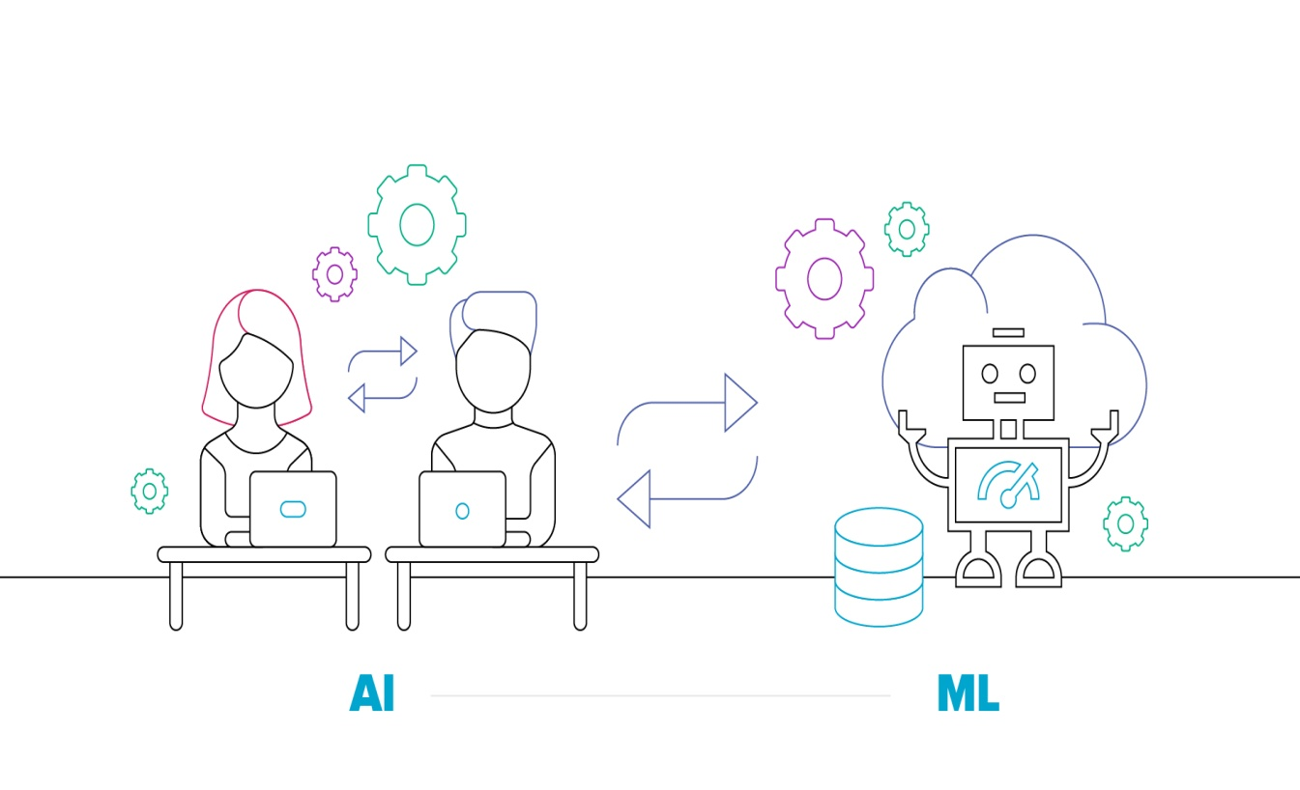

Objective & Outline
AI-driven forecasting platforms apply multiple algorithms to automatically determine the most relevant metrics for each product or SKU in the system. Time spent gathering, updating, integrating, and reconciling competing data from multiple spreadsheets is eliminated, allowing forecasting professionals to spend their time optimizing demand and coordinating with other departments such as marketing to find new revenue streams. The value of collaboration across departments and external partners, operating from a single source of truth, cannot be underestimated.

Slide 3
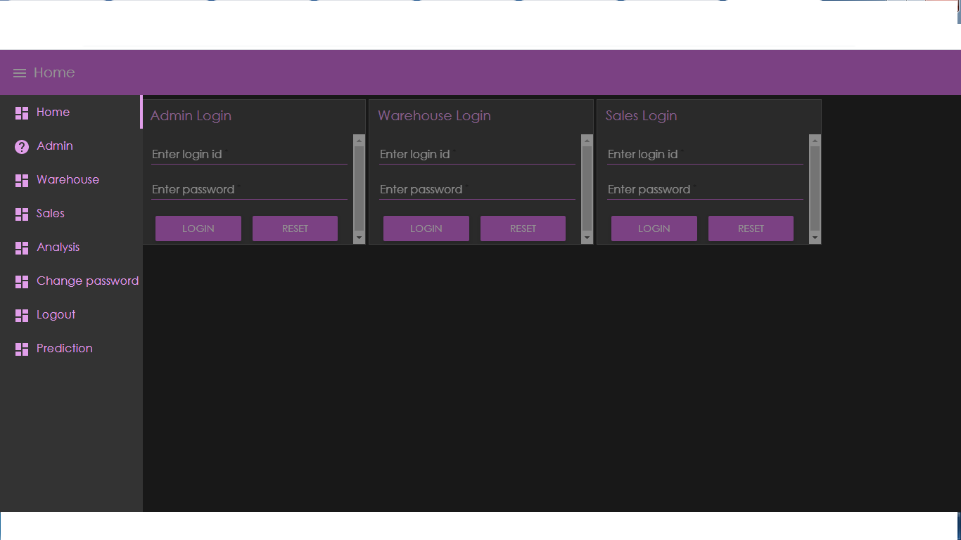
Building of UI
Some of the key advantages of a component-based design system.
Reusability encourages consistency for both UI and UX as components create a consistent experience wherever they’re used.
Atomic Design can be leveraged for better consistency as larger components are composed out of smaller components, reducing unexpected and disjoint experiences.
Components provide better collaboration between design and development, allowing your design language to evolve over time. Ideally, what you see on Sketch is what you build with React.
Design aspects such as typefaces, typography, primary and secondary colors can still be specified as part of the component design system.

Slide 4

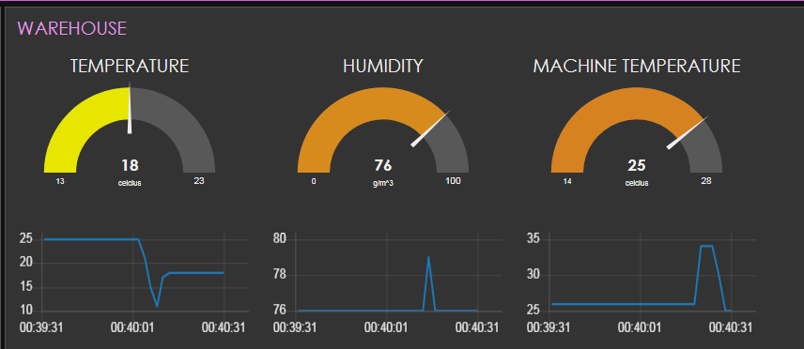
Temperature Sensor Using IOT
We all know that many accidents occurs due carelessness of people as they do not pay attention for the overheating of machine and which leads to great disaster.
But in our case we had taken precautions as we have taken measure for avoiding the miss happening by using IOT platform.
We have 3 Sensor which continually report the reading to our Dashboard.
When temperature increasing it automatically switch on the Buzzer and people come to know about it.
1
2
3

Slide 5
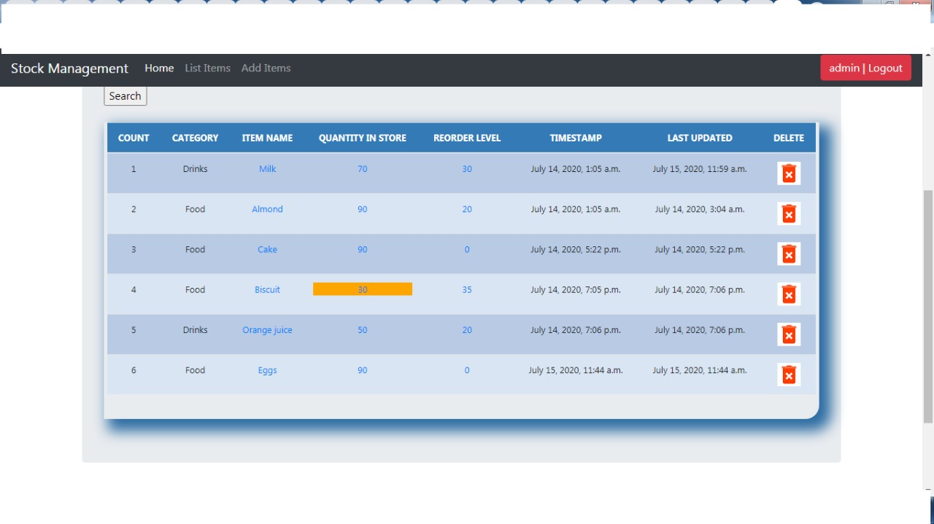

Stock Management
1. Tracking Inventory
2. Control your costs
3. Avoid over and under stock
4. Manage planning and forecasting
5. Reduce the time for managing inventory
To Insert a 3D Model:
1
Today, Stock Management has become vital for the survival of an organization. If you don’t have good control over your Stock, the day is not far when you will lose control of your profits.
2
Don’t let Stock excess or shortages decide your future. Invest in a good stock management solution.

Slide 6

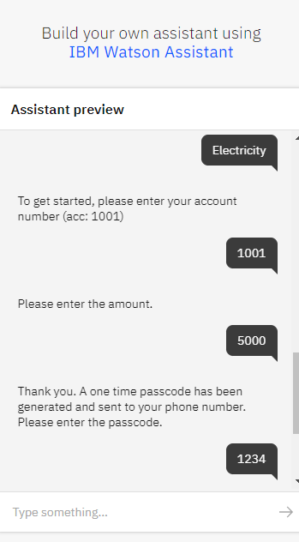
Chatbot using WATSON ASSISTANT
1
Our Chatbot uses AI technique which responds to all the queries by the customer.
2
With our Chatbot one could easily send or withdraw money also we can pay the electricity bill with our warehouse bot which we called it “Spoonacular” means it does everything with ease.

Slide 7
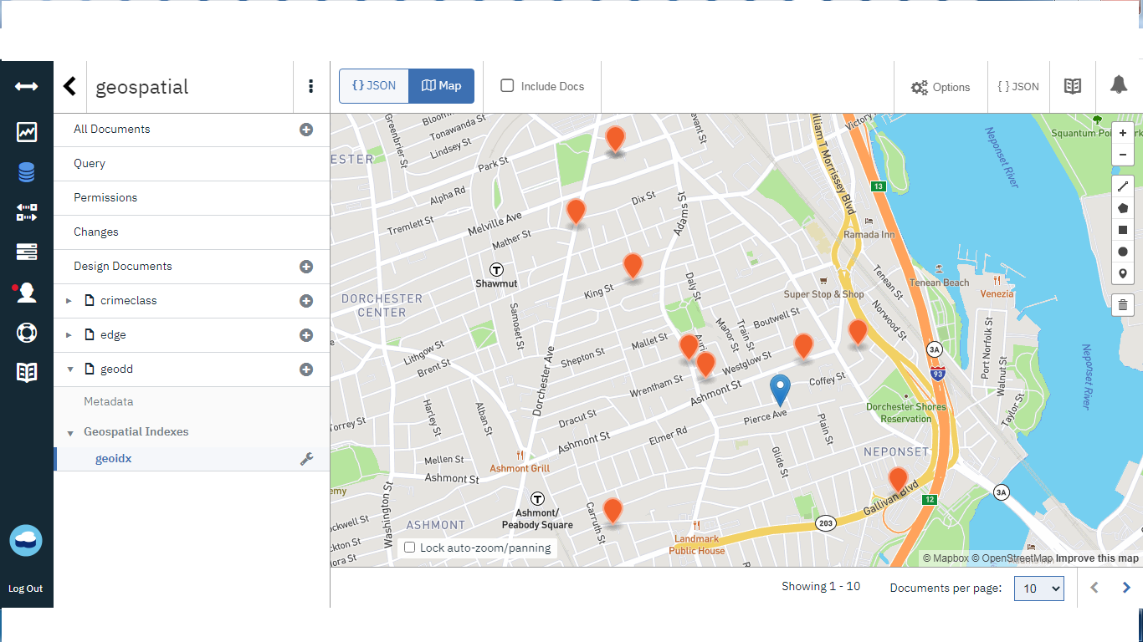
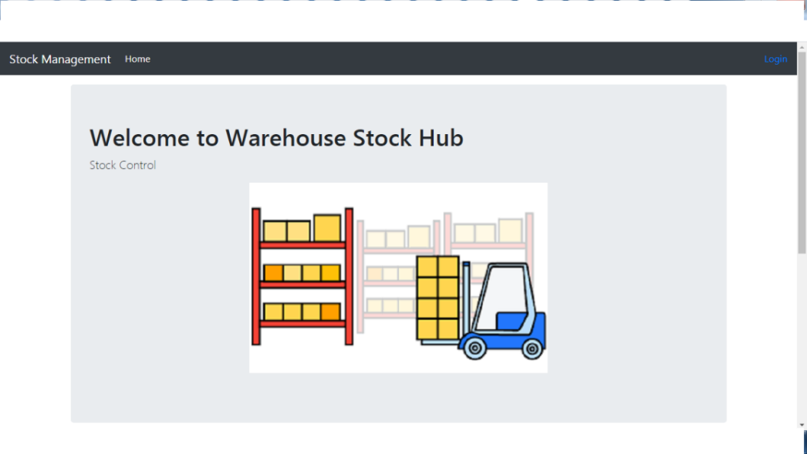
Specialty of Our Application
1
2
Cloudant
Django

Slide 8
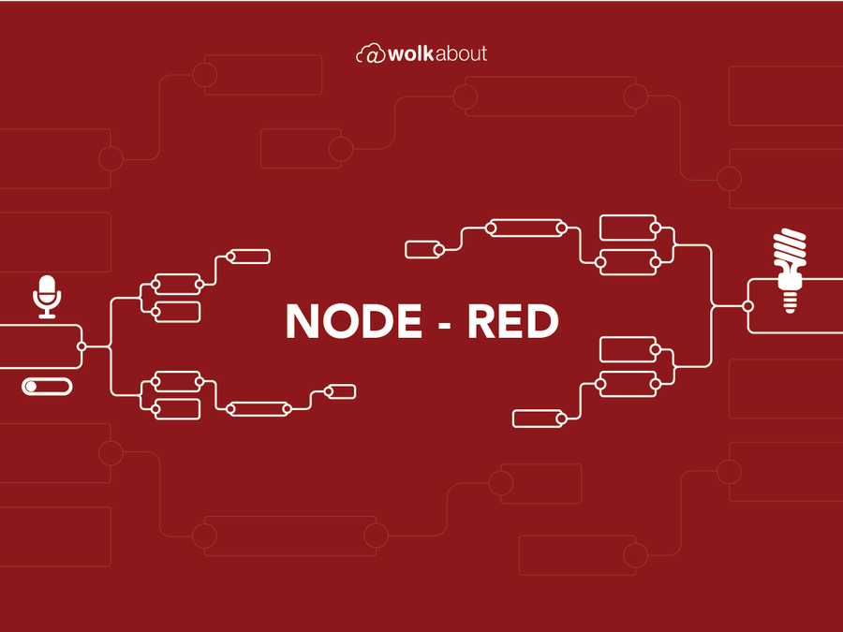



Challenges while Preparing this Project!!!!
1
Deployment to Node.js
2
Noval Corona Pandemic
3
Time Management

Slide 9


Experience Gained to Us:
Being B.Tech Final Year Students we came to know following:
1
Using IBM ID for various IBM Services Applications like Watson Assistant, Node Red, Cloudant , etc.
2
Integrating all the coding technique within one application like using JavaScript, Python, Django, etc together.
3
Gaining Knowledge with interacting with IBM Professors(Mentor).

Slide 10


Conclusion
Want to implement??
Source Code: Git Hub Repository
https://github.com/SmartPracticeschool/SBSPS-Challenge-3577-Optimized-Warehouse-Management-of-Perishable-Goods-for-a-Food-Delivery-Company

